Slide 1
AI Adoption & Workforce Impact Analysis
Excel project
SANDRA A

Slide 2
introduction
The aim of this project is to analyze AI adoption trends across industries and understand its impact on job roles, skills demand, and workforce dynamics to support data-driven business decisions.
Notes:
Goal: Understand how AI adoption influences workforce displacement, risk, and reskilling efforts.
Aim: Provide insights into industry, regional, and temporal trends in workforce impact.
Purpose: Help decision-makers identify vulnerable sectors, evaluate reskilling efforts, and highlight opportunities for AI-driven growth.

Slide 3
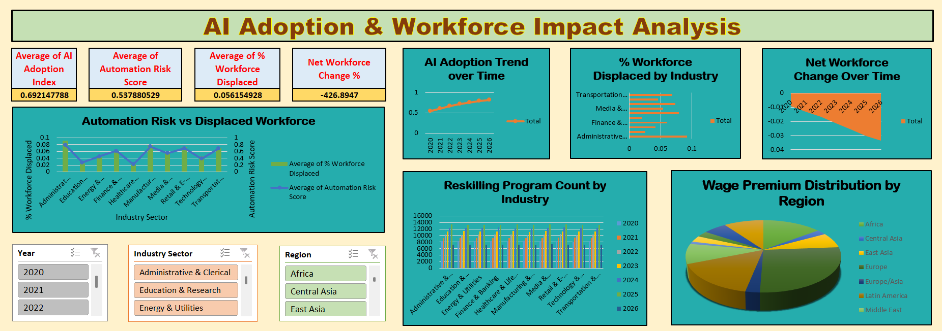
DASHBOARD overview

Slide 4
analysis
AI ADOPTION TREND OVER TIME
Finding: Adoption rates steadily increase across years
Insight: Growth is consistent across years, showing momentum in AI integration
Suggestion: Track adoption to forecast workforce needs
Notes:
Relevance: Shows global momentum

Slide 5
% Workforce Displaced by Industry
Finding:
Clerical, Manufacturing, retail, and logistics show highest displacement
Service industries less affected
Insight: Vulnerability is sector-specific
Suggestion: Target reskilling in high-displacement industries
Notes:
Relevance: Identifies vulnerable sectors

Slide 6
Automation Risk vs Workforce Displacement
Finding: Strong correlation between risk score and displacement
Insight: Industries with high risk also show higher displacement
Suggestion: Use risk scores as early warning indicators
Notes:
Relevance: Validates risk metrics.

Slide 7
Reskilling Program Count by Industry
Finding:
Steady increase in total reskilling programs across all industries over years
Administrative & Clerical sector has highest total (71,957) in 2025
Insight: Manufacturing & Logistics lags despite high displacement
Suggestion:
Expand reskilling in vulnerable industries
Partner with global learning platforms (IBM, Microsoft) to tailor industry‑specific reskilling
Notes:
Relevance: Shows imbalance in workforce adaptation.
showing strong reskilling focus

Slide 8
Wage Premium Distribution by Region
Finding: Europe and Latin America show highest wage premiums
Insight: AI skills are more economically rewarded in developed economies
Suggestion: Promote AI skill development in emerging economies
Notes:
Relevance: Highlights inequality in AI benefits.
Middle East/ Africa: 85.85

Slide 9
Net Workforce Change (%) Over Time
Finding: Net workforce change is negative overall, but stabilizes in later years
Insight: Job losses peak early, then slow down
Suggestion: Monitor recovery trends and support industries with persistent losses
Notes:
Relevance: Suggests adaptation over time.

Slide 10
findings
AI adoption is accelerating globally (Index ~0.82), but uneven across industries and regions
Workforce displacement (5.6%) is concentrated in manufacturing and low-income regions
Net workforce change is sharply negative, but reskilling programs mitigate long-term impact
Reskilling programs are growing, but high‑risk industries (Manufacturing, Transportation) lag behind in program counts
Wage premiums for AI skills highlight opportunities for workers who adapt
Notes:
Wage premium: Advantage – High income countries (Europe/ East Asia) > Africa/Latin America
Tot 0.69

Slide 11
Suggestions
Policy Recommendation: Expand reskilling programs in vulnerable industries
Business Strategy: Invest in AI skill development to capture wage premiums
Education: Promote AI literacy in emerging economies

Slide 12
conclusion
While global learning platforms from IBM and Microsoft provide valuable opportunities, the analysis shows that reskilling efforts remain uneven across industries and regions. Vulnerable sectors with the highest displacement risk are not benefiting proportionally. The key is to bridge the gap between global resources and local workforce needs, ensuring that reskilling is accessible, industry-specific, and aligned with the pace of AI adoption.
Notes:
Vulnerable industries like transportation and Administration face the greatest challenges, while reskilling efforts remain uneven.

Slide 13


